Slide 1
PATHWAYS TRANSITION PROGRAM 2025

Slide 2
WHAT IS PTP?
Initially launched in 2023, the Pathways Transition Program (PTP) aimed to support ~20 pre-categorized athletes, and their coaches, in their development by providing performance planning and performance support
Of 10 individual medalists at the 2024 World Under-20s, 5 were, or had been on PTP, and all were supported by AA (NASS) or our partners in some capacity, as were the majority of 4th-8th finishers
Since PTP, we went from 7th to 2nd on the World Under-20 Placing Table
Based on this success, we’re keen to expand the program!
PTP is a supportive learning environment designed to empower athletes and coaches.

Slide 3
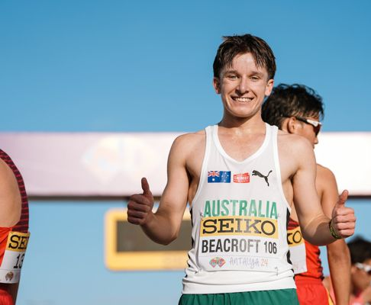
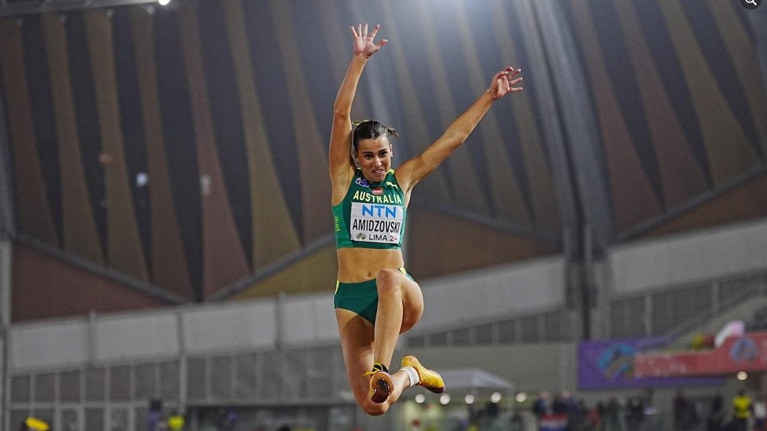
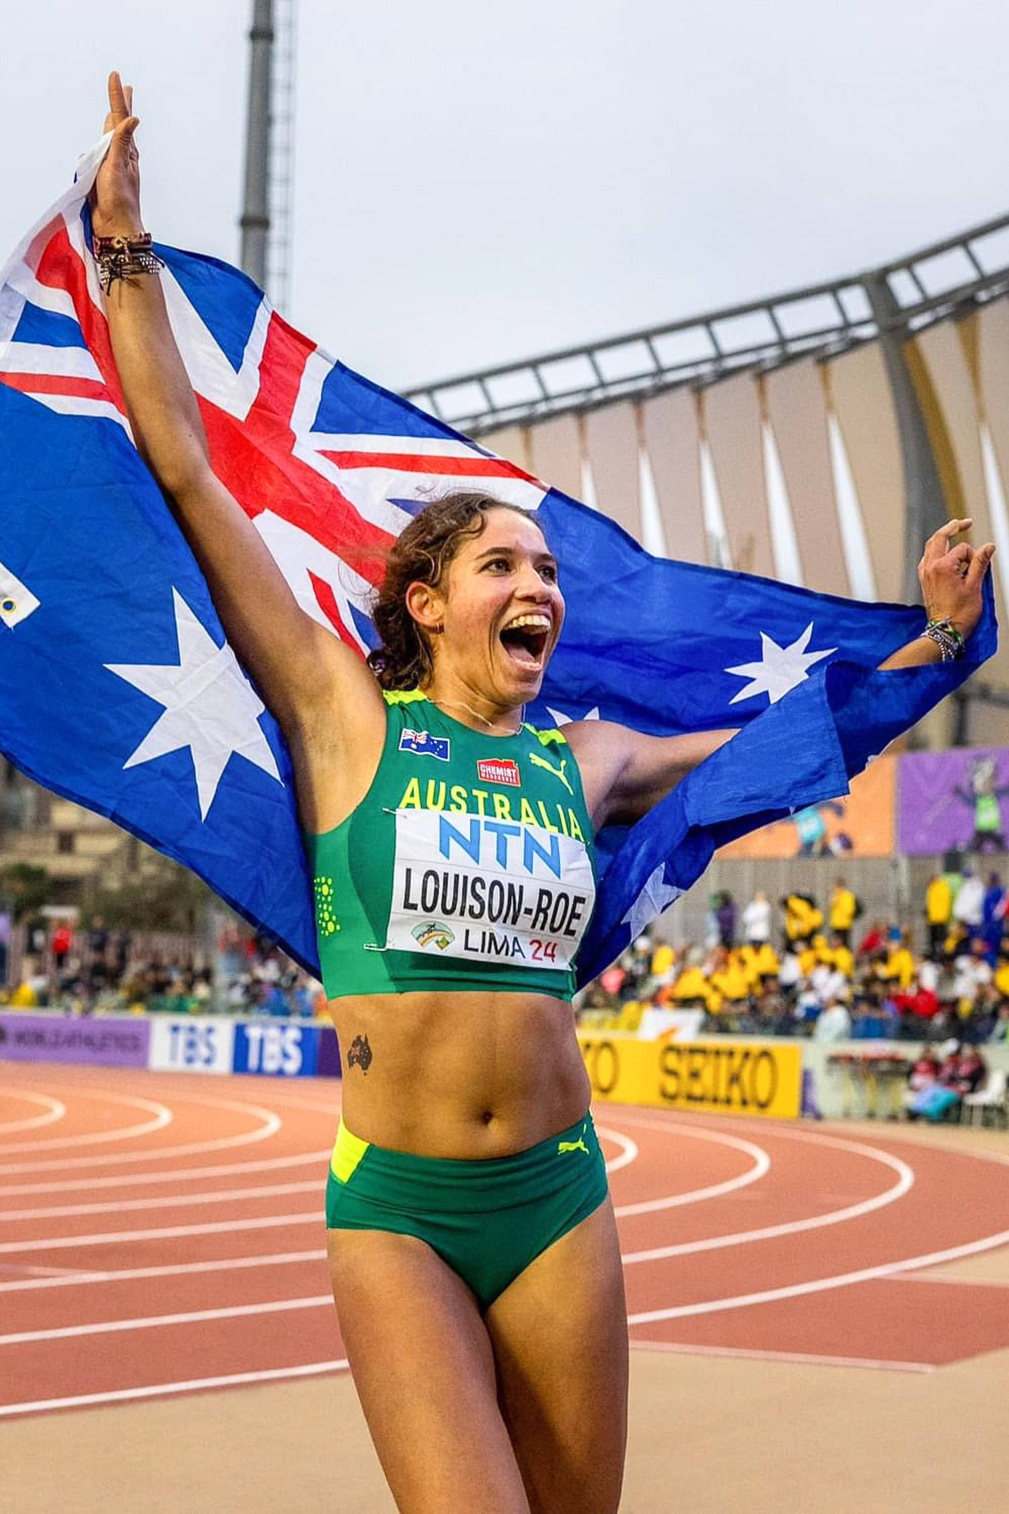
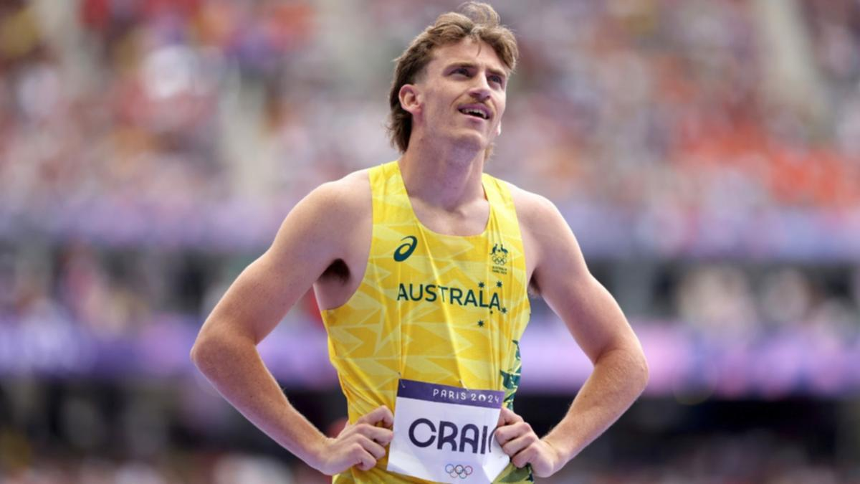
What the athletes say
The resources provided by PTP are the best in the country and were extremely beneficial for being able to get the most out of myself physically and also mentally in training and competition.
~Isaac Beacroft~
PTP has been a game-changer in my transition to higher levels of competition, providing the guidance and support I needed to succeed both on and off the track. ~Delta Amidzovski~
PTP has been a crucial key in my development from the transition of a junior into a senior athlete. The support received from all aspects of the PTP program was an instrumental tool in my 2024 season, helping me achieve my goal of running at the Olympic Games.
~Peyton Craig~
PTP has greatly contributed to my athletic journey, I have connected with and met many athletes across all events and have connected with their athletic experiences as well. With this I have gained valuable knowledge and have been opened up to important areas of athletics that I hadn't thought of before such as nutrition as well as the different areas of recovery.
~Izzi Louison-Roe~

Slide 4
What the coaches say
Being both a coach and a mother, participating in PTP alongside my athlete has been an invaluable experience. It’s given us both the tools to navigate the transition of Junior to senior levels together, helping my daughter grow as an individual athlete. I’ve also gained new insights and resources into supporting her journey.
~Becky Amidzovski – PTP Coach (Delta Amidzovski)~
The Australian Athletics Pathway Transition Program (PTP) has been a game-changer for Annabelle, guiding her journey from a promising athlete to a Paralympian. With its comprehensive programs and the unwavering passion of its staff and leaders, PTP empowers every athlete and coach to unlock their full potential and chase greatness.
~ Anthony DeCastella – PTP Coach (Anabelle Colman)~
PTP will surround you with all the right support you & your athlete require to be the best you can be as you advance through the athletic pathways, allowing you to build a team that will help you focus on your highest goals.
~Karen Roe – PTP Coach (Izzi Louison-Roe)~

Slide 5
WHAT DOES A BIGGER PROGRAM LOOK LIKE?
Up to 100 athletes supported in PTP:
PTP Core (~40 athletes)
Able / Para Athletes
PTP Relays (~20 athletes)
PTP Target 2032 (up to 20 athletes)
Talent Transfer
Event Group Projects
PTP Overseas Athlete (up to 20 athletes)
Athletes based overseas
NCAA athletes are eligible

Slide 6
WHAT DO ATHLETE/COACHES GET?
Access to key performance support services:
Sports Medicine
Screening / Consultation
Sports Physiotherapy
Screening / Consultation
Soft Tissue Therapy
In conjunction with an injury management plan
Biomechanics
WITTW Testing alignment
Targeted interventions / support
Performance Analysis from Track Classics / Nationals
Sports Psychology
Mental Performance in Competition
Consultation
Sports Nutrition
Assessment / consultation
Physiology
Performance preparation / Testing
S&C
Coach & Facility access
Skill Acquisition
Talent Transfer / Skill Development
Athlete Wellbeing & Engagement
Vocational Support
Generalised well-being support

Slide 7
WHAT DO ATHLETE/COACHES GET?
Travel assistance budget to support attendance at camps and key competitions
Coach development opportunities
A National PTP Camp
Target 2032 - Talent Transfer athletes only – Talent Transfer camp
Relay athletes only – support to attend relay camps
Overseas Athletes
Targeted remote performance support
Financial support for physio and S&C when in Australia

Slide 8
TARGET 2032
Why?
Australian Athletics would like to develop athletes to be internationally competitive in all events. The Target 2032 strategy looks to support athletes to consider events where they may have international performance potential. The aim is to develop pathways to support Australia to achieve top 16 finishes in all events at the Brisbane 2032 Olympics.
Talent Transfer
Where can we dedicate our resources to best plug any key gaps we might have?
We currently have events which lack the depth to provide opportunities for athletes to develop to an international standard.
We have incredible depth in some events where athletes could achieve international performance standards should they acquire the skills to transfer to alternate events.

Slide 9
Target 2032 : TALENT TRANSFER
Talent Transfer 2025/2026 – Hurdles (400mH / 3000mSC)
What are we looking for?
Athletes interested in a new challenge
400m – 5000m runners looking to move to a new event.
Up to 20 athletes will be selected from those who express their interest.
Training for the new event should assist performance in the initial event.
What do you get out of it?
A level of support similar to PTP
A new challenge
Coach development opportunities
2 x camps (Talent Transfer / PTP)
Travel Support where required to position athletes in developmental opportunities.
Targeted event projects:
National Event group panels will have the opportunity to propose a project that would assist in achieving the HP aims for 2032 and develop event specific capabilities to achieve top 16 performances in all events.

Slide 10
WHO CAN GET SELECTED?
Read the Selection Policy on the website to see whether you’re eligible
https://www.athletics.com.au/participant-hub/pathways/
Read the Terms of Reference to understand PTP engagement:
Complete an athlete profile survey
Complete and submit an annual plan with personal coach.
Complete a Gap to Podium (GTP) analysis with AA PTP Staff member.
Undertake a mid-year review.
Athlete and Coach to Attend PTP National Camp (not overseas athletes).
Relay athletes – attending relay camps
Note that, almost exclusively, 100-400m runners will only be considered for Relay PTP, unless they are based overseas.
Talent Transfer – commit to competing in the transfer event, and attend PTP Talent Transfer Camp.

Slide 11
WHO CAN GET SELECTED?
Core PTP / Overseas Athletes
Able-Bodied • For athletes in the Under-20 age group, any athlete who achieves the Australian Athletics World Under-20 standard. • For athletes in the Under-23 age group, any athlete who achieves performances in the PTP performance matrix relevant for their age. • Any athlete who, in the opinion of the Selection Panel, has the potential to win a medal for Australia at a future Benchmark Event.
Para-Athletes • For Under-21 athletes who have achieved the PTP Para performance standard (currently being refined, but once finalised based on the LA2028). • Any athlete who, in the opinion of the National Event Group Coaches and/or Selection Panel, has the potential to win a medal for Australia at a future Benchmark Event.

Slide 12
WHO CAN GET SELECTED?
PTP Relays • Athletes who have completed an EoI to form part of the Relay PTP, outlining their commitment to follow the Relay PTP Terms of Reference • Athletes who, in the opinion of the National Relay Coaches and/or Selection Panel, have the potential to compete in the relay for Australia at a future Benchmark Event.
PTP Talent Transfer • Athletes who have completed an EoI to form part of PTP Talent Transfer, outlining their commitment to the program across the membership program • Athletes who, in the opinion of the Selection Panel and External Experts, have the potential to develop into an athlete capable of selection for Australia at a future Benchmark Event in the target event.

Slide 13
Submit your expression of interest to be considered for selection
https://wkf.ms/4kwDRXu
Any questions or queries, please contact:
Adam Didyk
Pathway Transition Manager
adam.didyk@athletics.org.au
Jessica Pascoe Para Pathways Consultant
jessica.pascoe@athletics.org.au

Slide 14
QUESTIONS
Will PTP athletes be excluded from potential NASS selection in the future?
NASS Selection will occur prior to PTP, Athletes in PTP will be considered for NASS equal to their peers.
Will the program support US based Australian college athletes?
Yes, the PTP Overseas component will be available to NCAA athletes.
Can you be supported in both track and field events?
Yes, if athletes meet the standard in multiple events, they may be considered.
Will you view recovering injured athletes who have still accomplished results and have more to accomplish?
Athletes are encouraged to note any factors which they want considered in the EOI.
Is there assistance where an athlete / coach may be affected by remote location or distance to training and other programs?
This is a key advantage offered to PTP athletes / coaches.
Is the camp scheduled during holidays to minimise school disruption?
There are multiple factors to consider when selecting camp dates. The current aim will be for a camp in December.

